Slide 1
ETL (Extract-Transform-Load)

Slide 2
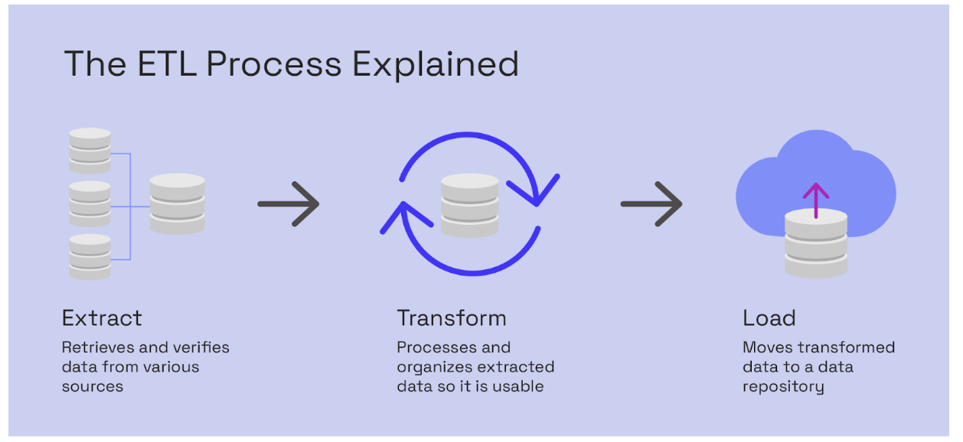
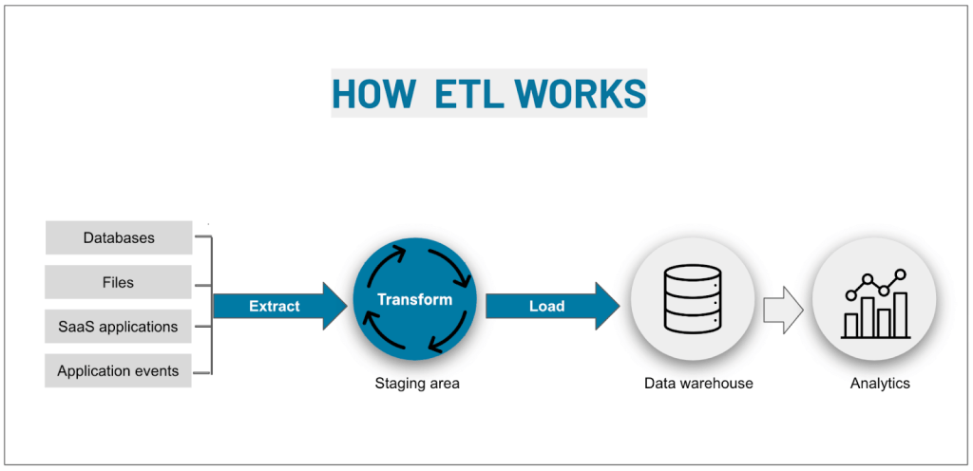
ETL
ETL 包括了擷取(Extract)、轉換(Transform)和載入 (Load) 三個動作．目的是將來自多個來源的資料合併至大型中央儲存庫 (稱為資料倉儲 Data warehouse) 的程序。
ETL 使用一組業務規則來清理和整理原始資料，並做好準備以進行儲存、資料分析和機器學習 (ML)。
之後企業組織可以透過資料分析來滿足特定的商業智慧需求 (例如預測商業決策的結果、產生報告和儀表板和工單、增加營運效率等)。

Slide 3
Text File
擷取純文字檔，主要的動作就是開啟檔案並讀取其內容，這個過程看似簡單，但其實也會遇到一些問題
檔案太大而無法放入記憶體做進一步的操作，此時需要重新改寫程式碼把檔案分段來處理、例如改為一次只處理一行的資料。
來源資料可能使用不同的編碼方式 (ASCII, Unicode or UTF-8)
讀取文字檔時的預設編碼是 UTF-8, 因為 UTF-8 被用於85%以上的 Web 網頁
Python的 open() 函式提供了 encoding 參數，可以用來指定編碼方式
利用 errors 參數值來避免程式錯誤
# 雙城記文本分析之ETL
from pathlib import Path
in_path = Path.cwd() / 'demo source files' /'雙城記開頭.txt'
out_path = Path.cwd() / 'demo source files' /'雙城記斷字.txt'
# Extract
with in_path.open(mode='r', encoding='utf-8') as file:
content = file.read()
# Transform
text = content.lower().replace(',','').replace('.','')
units = text.split('\n\n')
foo = units[0].split()
foo.extend(units[1].split())
count_dict = {}
for word in foo:
if word in count_dict:
count_dict[word] += 1
else:
count_dict[word] = 1
#Load
with out_path.open(mode='w', encoding='utf-8') as file:
for key, value in count_dict.items():
file.write(key + '|' + str(value) + '\n')
from pathlib import Path
# determine path
path = Path.cwd() /'特殊符號.txt'
# write content
with path.open(mode='wb') as file:
file.write(bytes([65, 66, 67, 255, 192, 193]))
with path.open(mode='r', errors='ignore') as file:
text1 = file.read()
print(text1)
with path.open(mode='r', errors='replace') as file:
text2 = file.read()
print(text2)
with path.open(mode='r') as file:
text5 = file.read()
print(text5)

Slide 4
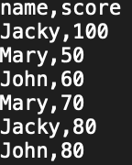
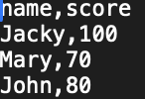
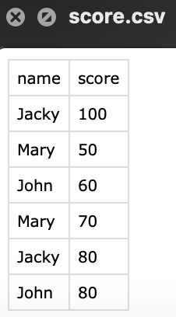
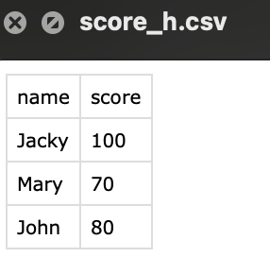
CSV File
from pathlib import Path
import csv
path = Path.cwd() / 'demo source files' / 'score.csv’
# Extract
h_score_dict = {}
with path.open(mode='r', encoding='utf-8') as file:
reader = csv.DictReader(file)
header = reader.fieldnames
# Transform
for row in reader:
if row['name'] not in h_score_dict:
h_score_dict[row['name']] = int(row['score'])
elif int(row['score']) > h_score_dict[row['name']]:
h_score_dict[row['name']] = int(row['score’])
# Load
output_list = []
for key, value in h_score_dict.items():
output_dict = {}
output_dict['name'] = key
output_dict['score'] = value
output_list.append(output_dict)
print(output_list)
out_path = Path.cwd() / 'demo source files' / 'score_h.csv'
with out_path.open(mode='w', encoding='utf-8', newline='') as file:
writer = csv.DictWriter(file, fieldnames = ['name','score'])
writer.writeheader()
writer.writerows(output_list)
讀取score.csv的姓名及分數，幫每個人算出最高成績，最後將最高成績寫入score_h.csv
[{'name':'Jacky', ‘score’:100},
{'name':'Mary', ‘score’:70},
{'name’:’John', ‘score’:80}]

